Slide 1
Fundamentals
Computer Architecture
Yan Shoshitaishvili
Arizona State University

Slide 2
All roads lead to the CPU
Source Code
Python, JavaScript, Java
C, C++, Rust
Intermediate Language Bytecode
Interpreter or JIT
Compiler
Binary-encoded Instructions
CPU

Slide 3








Digging Deeper
http://www.electronics-tutorials.ws/logic/logic_1.html

Slide 4
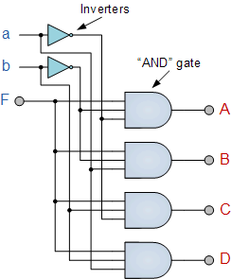
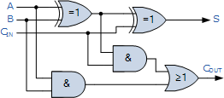
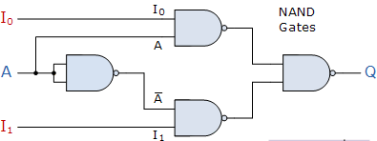
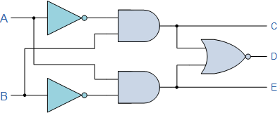
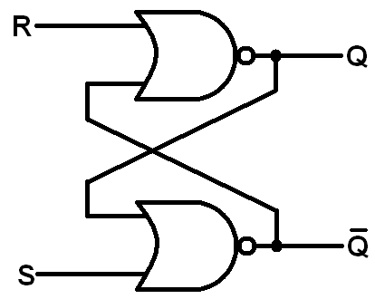
Too deep!
http://www.electronics-tutorials.ws/category/combination

Slide 5
Computer Architecture (very high level)
Memory
CPU
Disk
"Some sort of bridge."
Network + Others

Slide 6
Computer Architecture (drilling down)
Memory
CPU
Disk
Registers
CU
"Some sort of bridge."
ALU
Network + Others

Slide 7
Computer Architecture (further down!)
Memory
CPU
Disk
Registers
CU
"Some sort of bridge."
Cache
ALU
Network + Others

Slide 8
Computer Architecture (as far as we'll go)
CPU
Memory
L2
Cache
Registers
CU
Disk
L1 Cache
ALU
"Some sort of bridge."
Registers
CU
Network + Others
L1 Cache
ALU

Slide 9
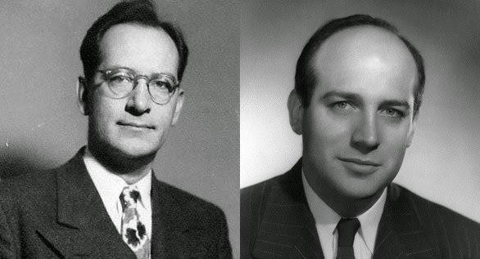
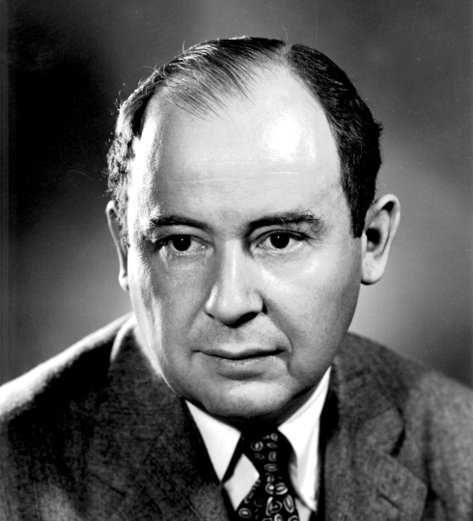
John Mauchly (Physicist), John Presper Eckert (Electrical Engineer), John Von Neumann (Mathematician)
John von Neumann, First Draft of a Report on the EDVAC, 1945.

